Slide 1
Introduction to RNNs
Shangsong Liang
Sun Yat-sen University
Originally produced by Arun Mallya

Slide 2
Outline
Why Recurrent Neural Networks (RNNs)?
The Vanilla RNN unit
The RNN forward pass
Backpropagation refresher
The RNN backward pass
Issues with the Vanilla RNN
The Long Short-Term Memory (LSTM) unit
The LSTM Forward & Backward pass
LSTM variants and tips
  Peephole LSTM
  GRU

Slide 3
Motivation
Not all problems can be converted into one with fixed-length inputs and outputs
Problems such as Speech Recognition or Time-series Prediction require a system to store and use context information
  Simple case: Output YES if the number of 1s is even, else NO
  1000010101 – YES, 100011 – NO, …
Hard/Impossible to choose a fixed context window
  There can always be a new sample longer than anything seen

Slide 4
Recurrent Neural Networks (RNNs)
Recurrent Neural Networks take the previous output or hidden states as inputs.
The composite input at time t has some historical information about the happenings at time T < t
RNNs are useful as their intermediate values (state) can store information about past inputs for a time that is not fixed a priori

Slide 5
Sample Feed-forward Network
y₁
h₁
x₁
t = 1

Slide 6
Sample RNN
y₃
y₂
h₃
y₁
h₂
x₃
h₁
t = 3
x₂
x₁
t = 2
t = 1

Slide 7
Sample RNN
y₃
y₂
h₃
y₁
h₂
x₃
h₁
t = 3
x₂
h₀
t = 2
x₁
t = 1

Slide 8
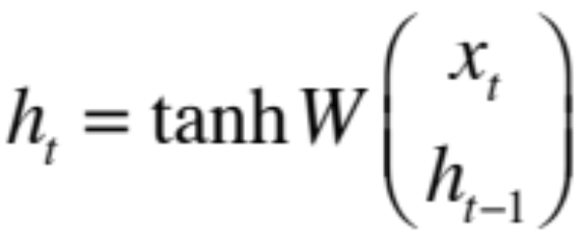
The Vanilla RNN Cell
x_{t}
h_{t-1}
W
h_{t}

Slide 9
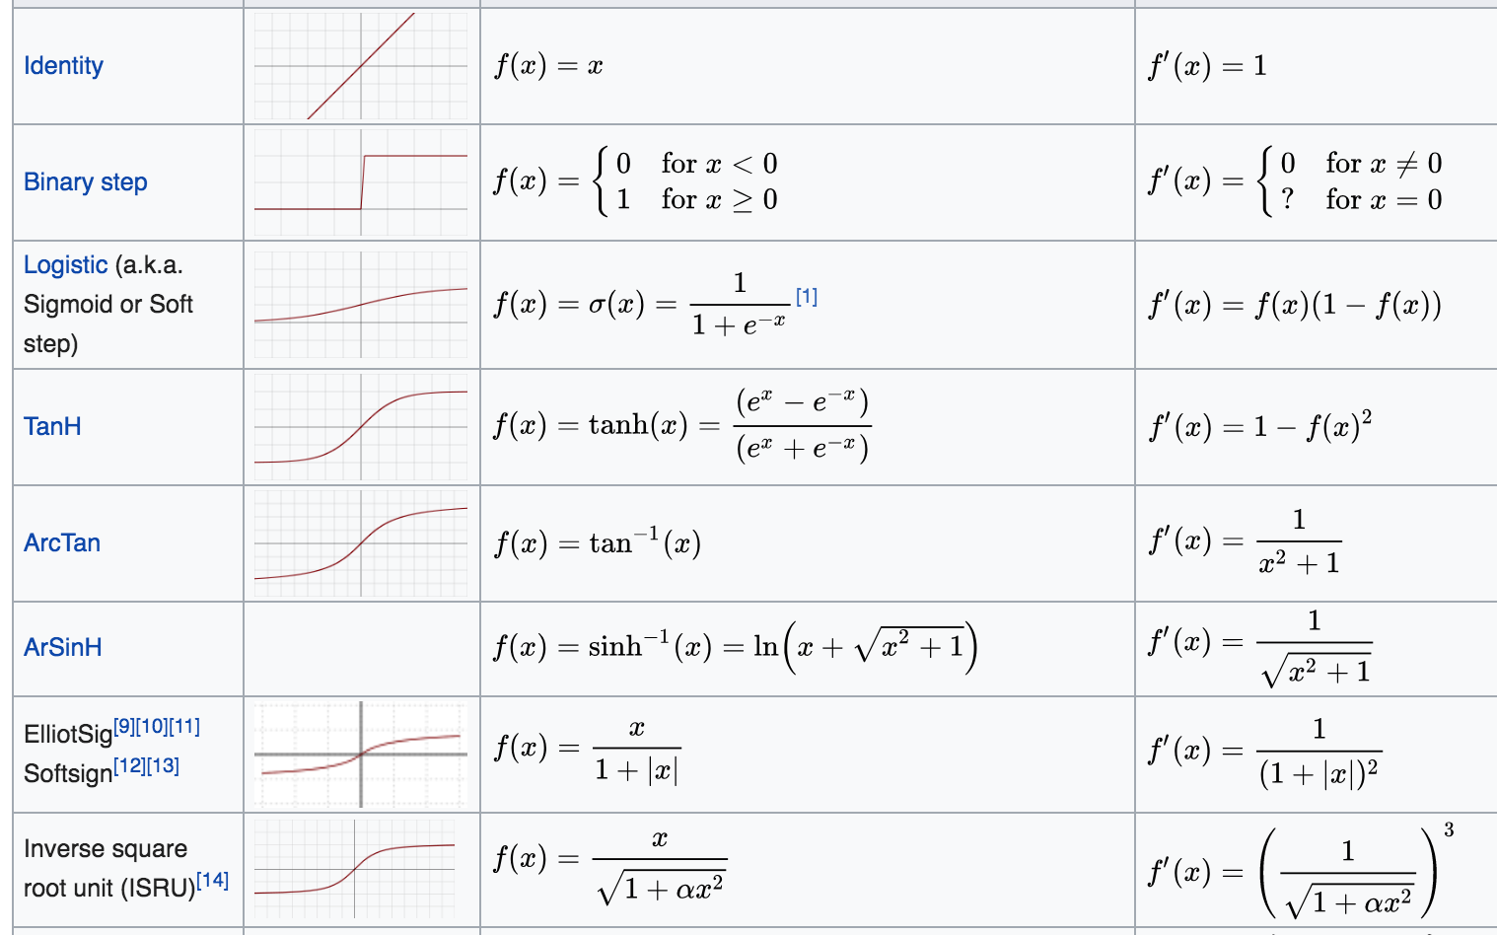

Slide 10
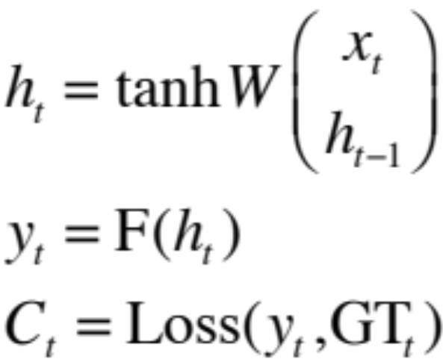
The Vanilla RNN Forward
C₁
C₂
C₃
y₁
y₂
y₃
x₁ h₀
x₂ h₁
h₁
x₃ h₂
h₂
h₃

Slide 11
The Vanilla RNN Forward
C₁
C₂
C₃
y₁
y₂
y₃
x₁ h₀
x₂ h₁
h₁
x₃ h₂
h₂
h₃
indicates shared weights

Slide 12
Recurrent Neural Networks (RNNs)
Note that the weights are shared over time
Essentially, copies of the RNN cell are made over time (unrolling/unfolding), with different inputs at different time steps

Slide 13
Sentiment Classification
Classify a
restaurant review from Yelp! OR
movie review from IMDB OR
…
as positive or negative
Inputs: Multiple words, one or more sentences
Outputs: Positive / Negative classification
“The food was really good”
“The chicken crossed the road because it was uncooked”

Slide 14
Sentiment Classification
RNN
h₁
The

Slide 15
Sentiment Classification
RNN
RNN
h₁
h₂
The
food

Slide 16
Sentiment Classification
h_{n}
RNN
RNN
RNN
h₁
h₂
h_{n-1}
The
food
good

Slide 17


Sentiment Classification
Linear Classifier
h_{n}
RNN
RNN
RNN
h₁
h₂
h_{n-1}
The
food
good

Slide 18
Sentiment Classification
Ignore
Ignore
Linear Classifier
h₁
h₂
h_{n}
RNN
RNN
RNN
h₁
h₂
h_{n-1}
The
food
good

Slide 19
Sentiment Classification
h = Sum(…)
h₁
h_{n}
h₂
RNN
RNN
RNN
h₁
h₂
h_{n-1}
The
food
good
http://deeplearning.net/tutorial/lstm.html

Slide 20
Sentiment Classification
Linear Classifier
h = Sum(…)
h₁
h_{n}
h₂
RNN
RNN
RNN
h₁
h₂
h_{n-1}
The
food
good
http://deeplearning.net/tutorial/lstm.html

Slide 21
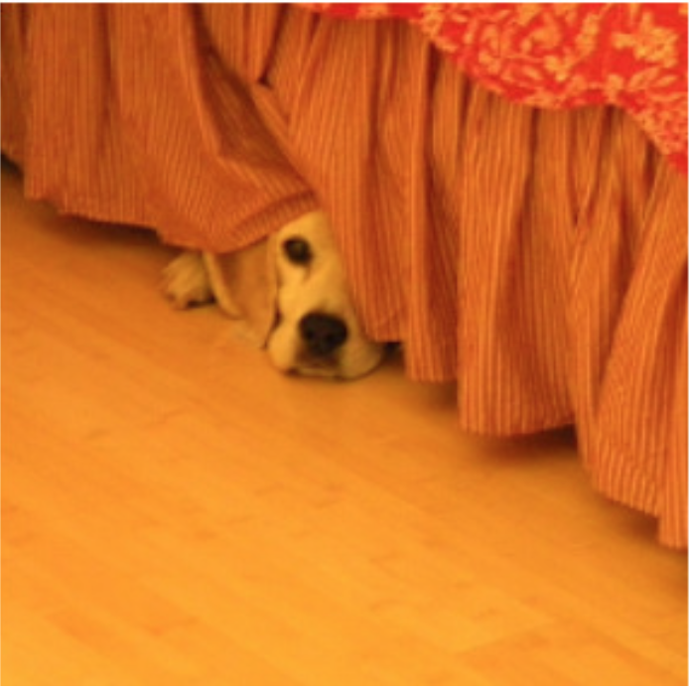
Image Captioning
Given an image, produce a sentence describing its contents
Inputs: Image feature (from a CNN)
Outputs: Multiple words (let’s consider one sentence)
: The dog is hiding

Slide 22
Image Captioning
RNN
CNN

Slide 23
Image Captioning
The
Linear Classifier
h₂
RNN
RNN
h₁
h₂
CNN

Slide 24
Image Captioning
The
dog
Linear Classifier
Linear Classifier
h₂
h₃
RNN
RNN
RNN
h₁
h₂
h₃
CNN

Slide 25
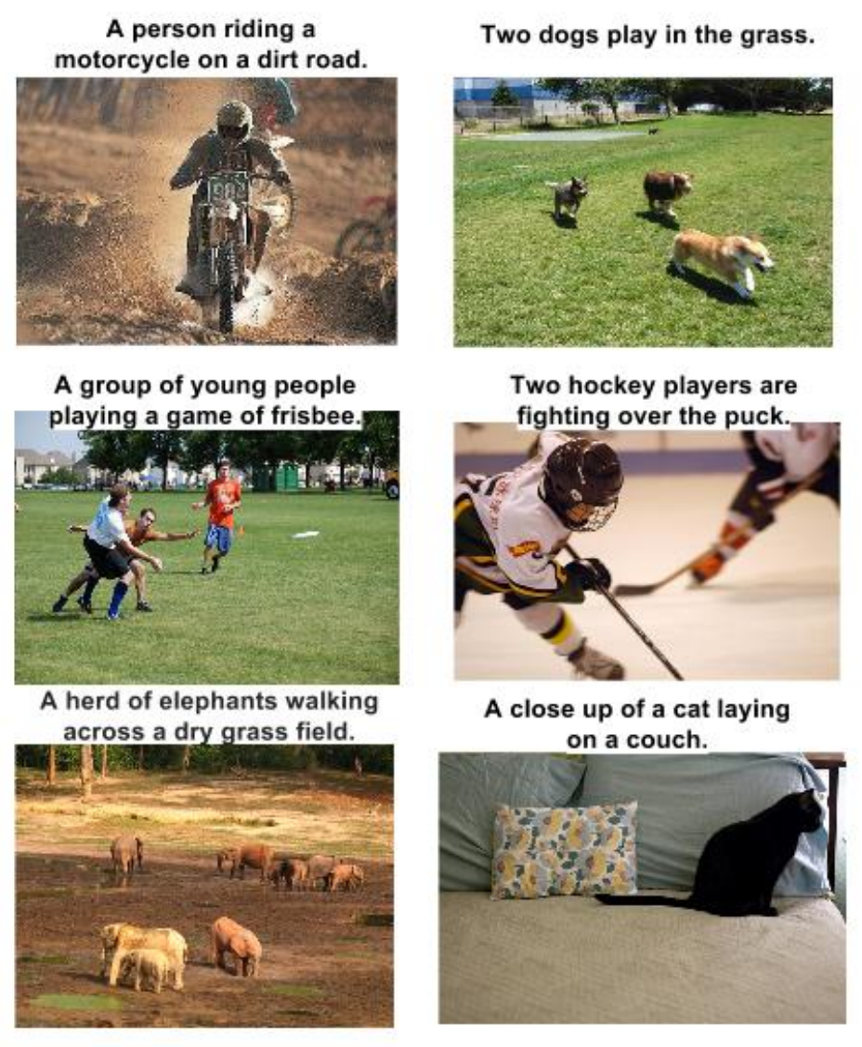
RNN Outputs: Image Captions
Show and Tell: A Neural Image Caption Generator, CVPR 15

Slide 26
RNN Outputs: Language Modeling
VIOLA:
Why, Salisbury must find his flesh and thought
That which I am not aps, not a man and in fire,
To show the reining of the raven and the wars
To grace my hand reproach within, and not a fair are hand,
That Caesar and my goodly father's world;
When I was heaven of presence and our fleets,
We spare with hours, but cut thy council I am great,
Murdered and by thy master's ready there
My power to give thee but so much as hell:
Some service in the noble bondman here,
Would show him to her wine.
KING LEAR:
O, if you were a feeble sight, the courtesy of your law,
Your sight and several breath, will wear the gods
With his heads, and my hands are wonder'd at the deeds,
So drop upon your lordship's head, and your opinion
Shall be against your honour.
http://karpathy.github.io/2015/05/21/rnn-effectiveness/

Slide 27
Input – Output Scenarios
Single - Single
Feed-forward Network
Single - Multiple
Image Captioning
Multiple - Single
Sentiment Classification
Multiple - Multiple
Translation

Slide 28
Input – Output Scenarios
Note: We might deliberately choose to frame our problem as a
particular input-output scenario for ease of training or
better performance.
For example, at each time step, provide previous word as
input for image captioning
(Single-Multiple to Multiple-Multiple).

Slide 29
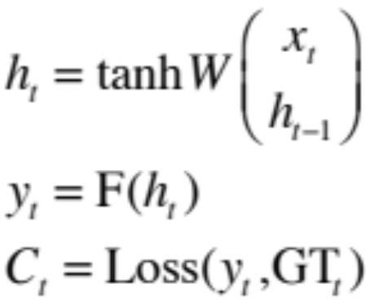
The Vanilla RNN Forward
C₁
C₂
C₃
y₁
y₂
y₃
x₁ h₀
x₂ h₁
h₁
x₃ h₂
h₂
“Unfold” network through time by making copies at each time-step
h₃

Slide 30
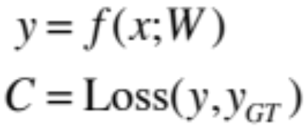
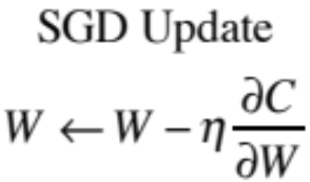
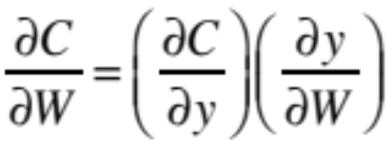
BackPropagation Refresher
C
y
f(x; W)
x

Slide 31
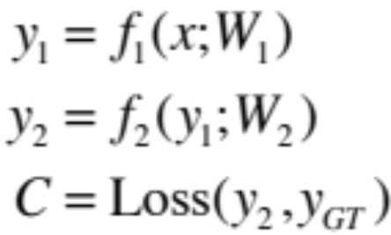
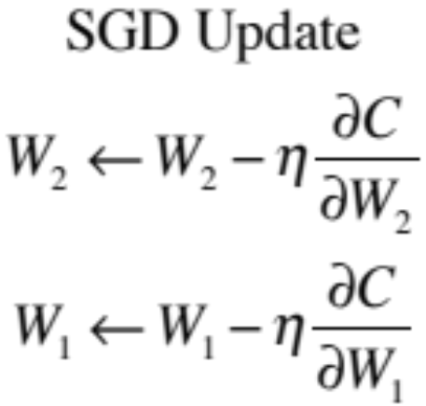
Multiple Layers
C
y₂
f₂(y₁; W₂)
y₁
f₁(x; W₁)
x

Slide 32
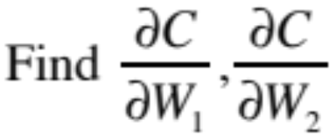
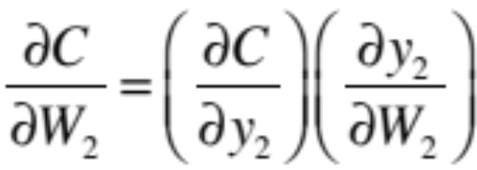
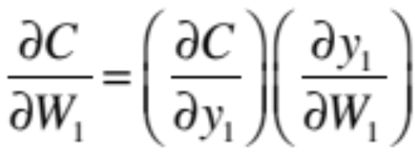
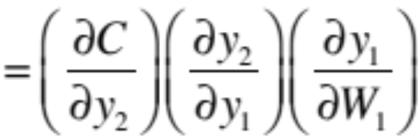
Chain Rule for Gradient Computation
C
y₂
f₂(y₁; W₂)
y₁
f₁(x; W₁)
x
Application of the Chain Rule

Slide 33
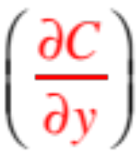
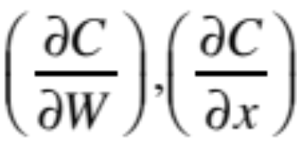
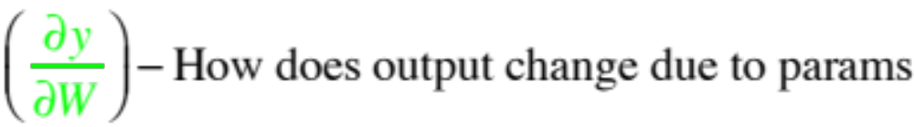
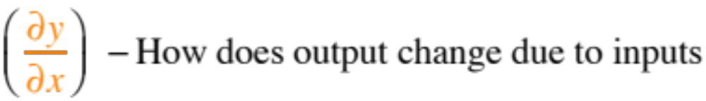
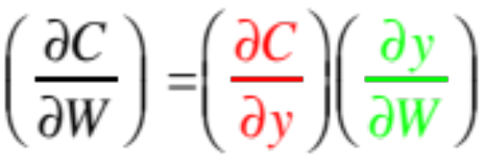
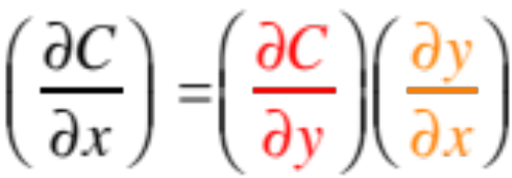
Chain Rule for Gradient Computation
Given:
We are interested in computing:
y
Intrinsic to the layer are:
f(x; W)
x

Slide 34
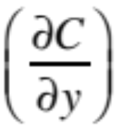
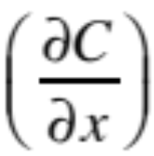
Chain Rule for Gradient Computation
Given:
We are interested in computing:
Intrinsic to the layer are:
f(x; W)
Equations for common layers: http://arunmallya.github.io/writeups/nn/backprop.html

Slide 35
Extension to Computational Graphs
y₁
y₂
y
f₁(y; W₁)
f₂(y; W₂)
f(x; W)
y
y
x
f(x; W)
x

Slide 36
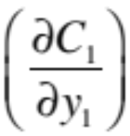
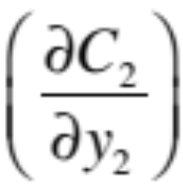
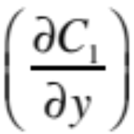
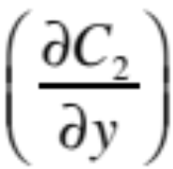

Extension to Computational Graphs
f₁(y; W₁)
f₂(y; W₂)
f(x; W)
f(x; W)

Slide 37
Extension to Computational Graphs
f₁(y; W₁)
f₂(y; W₂)
f(x; W)
Gradient Accumulation
f(x; W)

Slide 38
BackPropagation Through Time (BPTT)
One of the methods used to train RNNs
The unfolded network (used during forward pass) is treated as one big feed-forward network
This unfolded network accepts the whole time series as input
The weight updates are computed for each copy in the unfolded network, then summed (or averaged) and then applied to the RNN weights

Slide 39
The Unfolded Vanilla RNN
C₁
C₂
C₃
y₁
y₂
y₃
Treat the unfolded network as one big feed-forward network!
This big network takes in entire sequence as an input
Compute gradients through the usual backpropagation
Update shared weights
h₁
h₃
h₂
h₂
h₁
h₀
x₁
x₂
x₃

Slide 40
The Unfolded Vanilla RNN Forward
C₁
C₂
C₃
y₁
y₂
y₃
x₁ h₀
x₂ h₁
h₁
x₃ h₂
h₂
h₃

Slide 41
The Unfolded Vanilla RNN Backward
C₁
C₂
C₃
y₁
y₂
y₃
x₁ h₀
x₂ h₁
h₁
x₃ h₂
h₂
h₃
Notes:
refresher for backprop before this

Slide 42
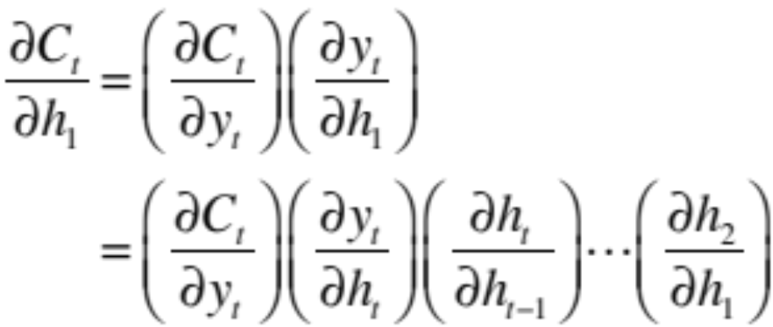
The Vanilla RNN Backward
C₁
C₂
C₃
y₁
y₂
y₃
x₁ h₀
x₂ h₁
h₁
x₃ h₂
h₂
h₃
Notes:
refresher for backprop before this

Slide 43





Issues with the Vanilla RNNs
In the same way a product of k real numbers can shrink to zero or explode to infinity, so can a product of matrices
It is sufficient for , where is the largest singular value of W, for the vanishing gradients problem to occur and it is necessary for exploding gradients that , where for the tanh non-linearity and for the sigmoid non-linearity ¹
Exploding gradients are often controlled with gradient element-wise or norm clipping
¹ On the difficulty of training recurrent neural networks, Pascanu et al., 2013

Slide 44
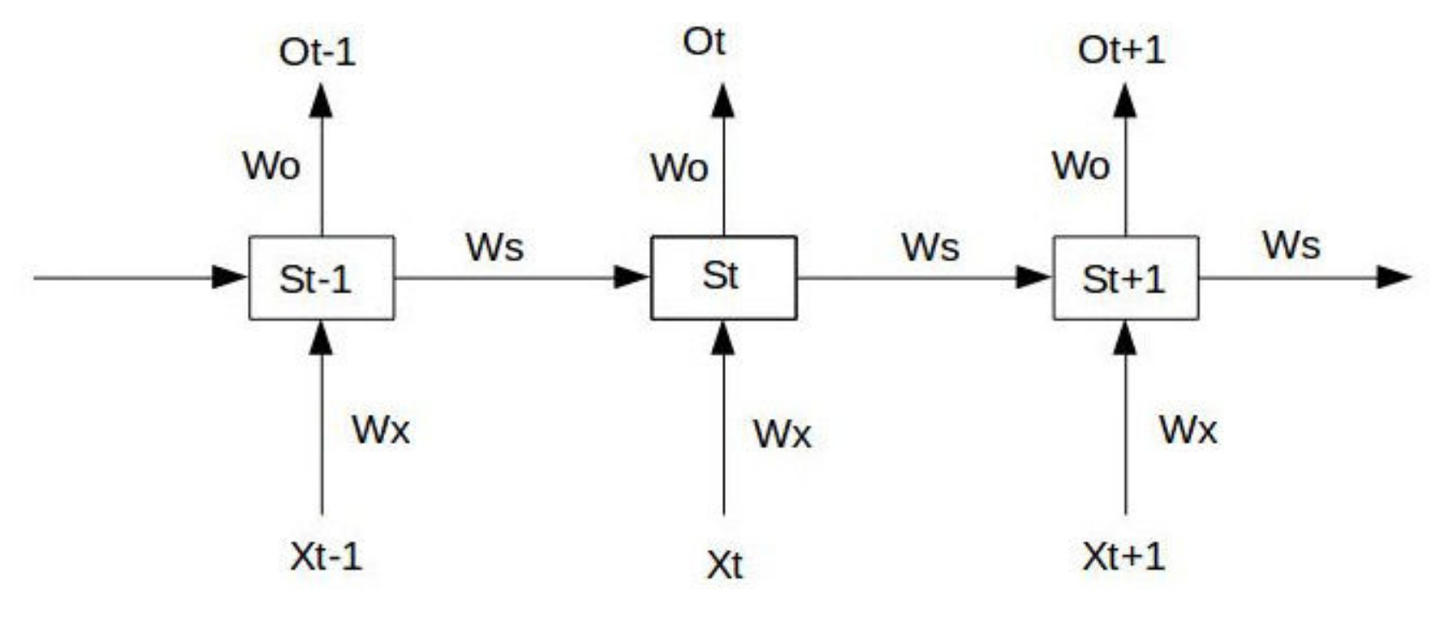
RNN梯度消失和爆炸例子

Slide 45
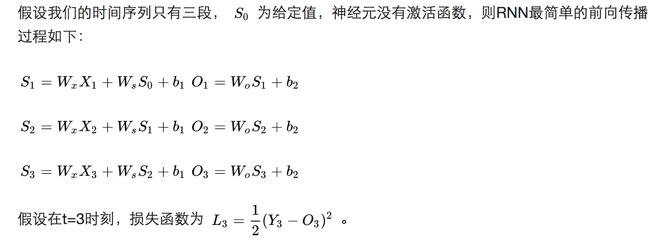
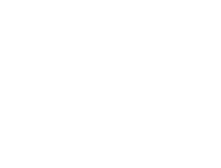
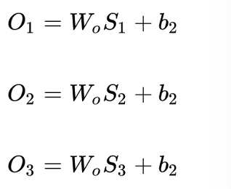
RNN梯度消失和爆炸例子

Slide 46
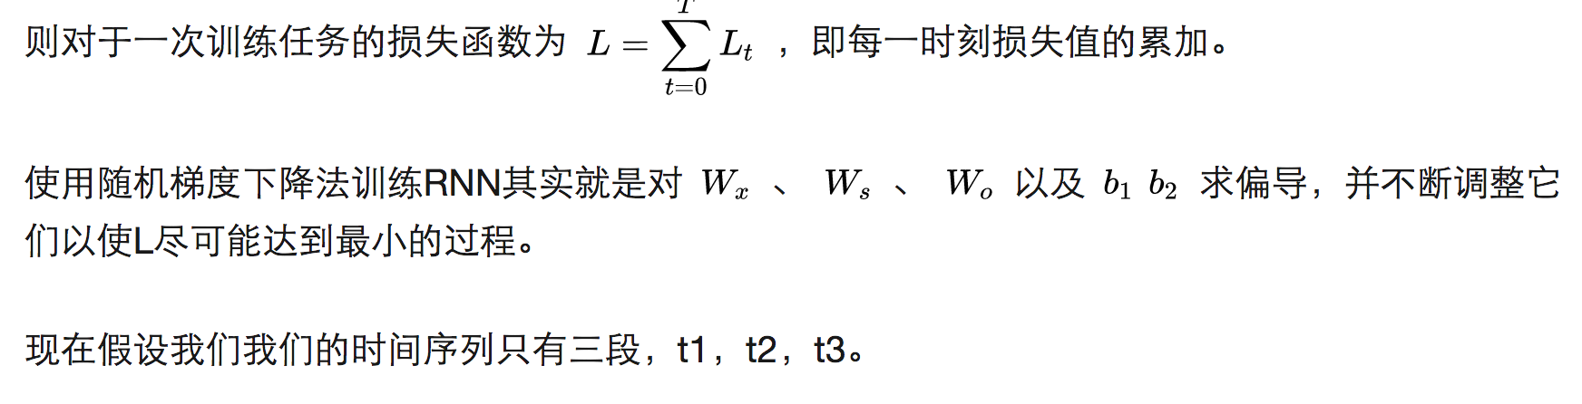
RNN梯度消失和爆炸例子

Slide 47
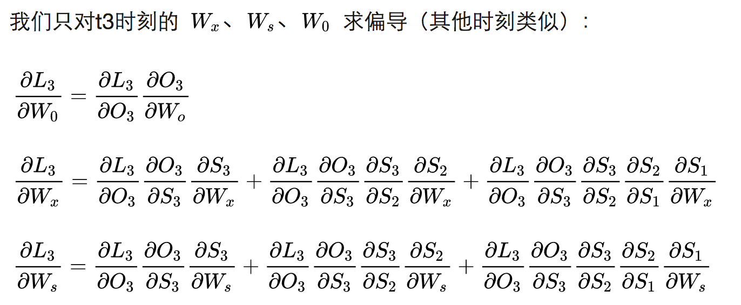
RNN梯度消失和爆炸例子

Slide 48
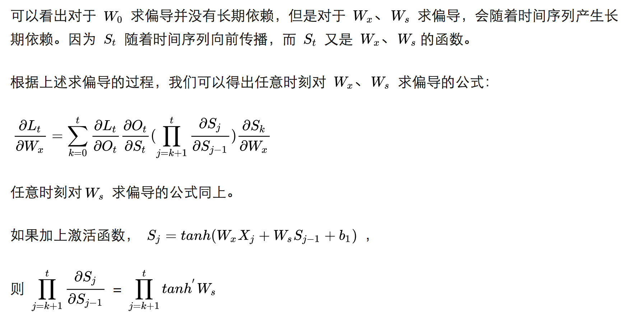
RNN梯度消失和爆炸例子

Slide 49
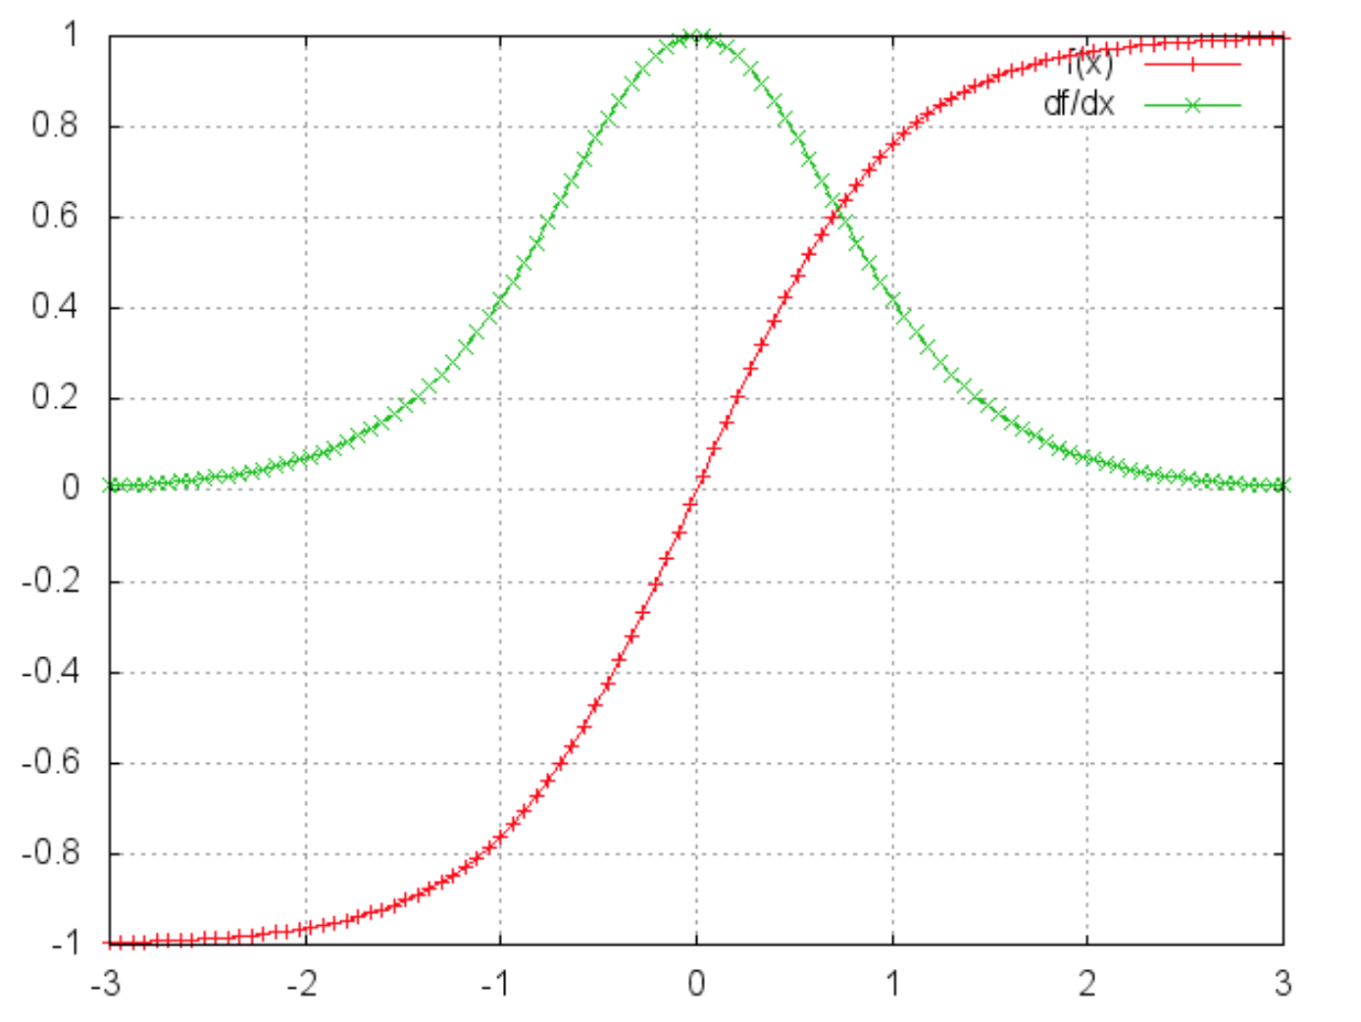
RNN梯度消失和爆炸例子
激活函数tanh和它的导数图像

Slide 50
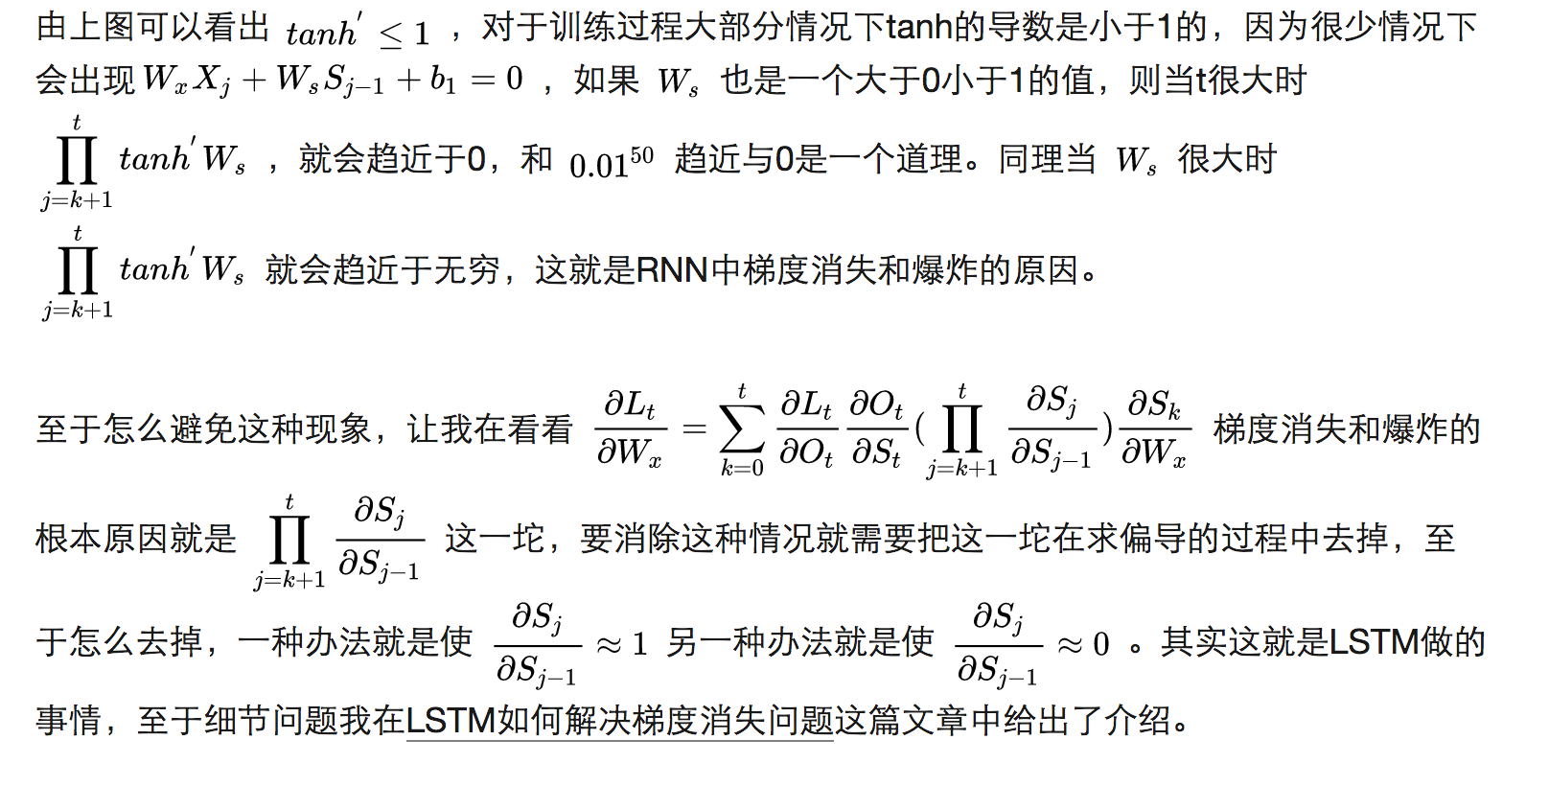
RNN梯度消失和爆炸例子

Slide 51

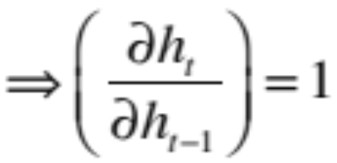
The Identity Relationship
Recall
Suppose that instead of a matrix multiplication, we had an identity relationship between the hidden states
The gradient does not decay as the error is propagated all the way back aka “Constant Error Flow”

Slide 52
The Identity Relationship
Recall
Suppose that instead of a matrix multiplication, we had an identity relationship between the hidden states
Remember Resnets?
The gradient does not decay as the error is propagated all the way back aka “Constant Error Flow”

Slide 53
Disclaimer
The explanations in the previous few slides are handwavy
For rigorous proofs and derivations, please refer to
On the difficulty of training recurrent neural networks, Pascanu et al., 2013
Long Short-Term Memory, Hochreiter et al., 1997
And other sources

Slide 54
Long Short-Term Memory (LSTM)¹
The LSTM uses this idea of “Constant Error Flow” for RNNs to create a “Constant Error Carousel” (CEC) which ensures that gradients don’t decay
The key component is a memory cell that acts like an accumulator (contains the identity relationship) over time
Instead of computing new state as a matrix product with the old state, it rather computes the difference between them. Expressivity is the same, but gradients are better behaved
¹ Long Short-Term Memory, Hochreiter et al., 1997

Slide 55
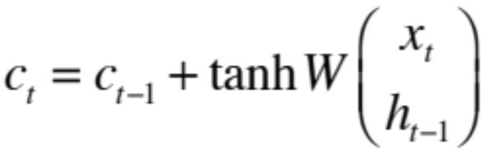

The LSTM Idea
x_{t}
h_{t-1}
W
Cell
c_{t}
h_{t}
* Dashed line indicates time-lag

Slide 56
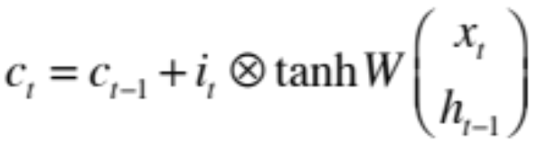
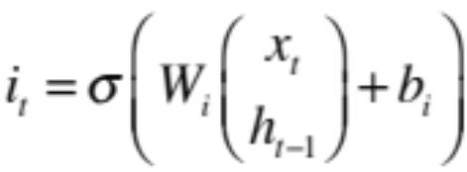

The Original LSTM Cell
x_{t} h_{t-1}
x_{t} h_{t-1}
W_{i}
W_{o}
Input Gate
i_{t}
Output Gate
o_{t}
x_{t}
h_{t-1}
W
Cell
c_{t}
h_{t}
Similarly for o_{t}

Slide 57
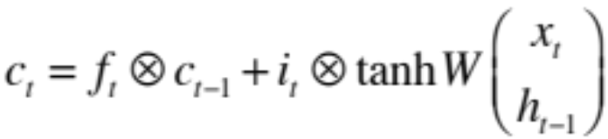
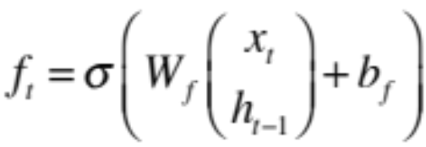
The Popular LSTM Cell
x_{t} h_{t-1}
x_{t} h_{t-1}
W_{i}
W_{o}
Input Gate
i_{t}
Output Gate
o_{t}
x_{t}
h_{t-1}
W
Cell
c_{t}
h_{t}
f_{t}
Forget Gate
W_{f}
x_{t} h_{t-1}

Slide 58
LSTM – Forward/Backward
Go To: Illustrated LSTM Forward and Backward Pass

Slide 59
Summary
RNNs allow for processing of variable length inputs and outputs by maintaining state information across time steps
Various Input-Output scenarios are possible
(Single/Multiple)
Vanilla RNNs are improved upon by LSTMs which address the vanishing gradient problem through the CEC
Exploding gradients are handled by gradient clipping
More complex architectures are listed in the course materials for you to read, understand, and present

Slide 60
Other Useful Resources / References
http://cs231n.stanford.edu/slides/winter1516_lecture10.pdf
http://www.cs.toronto.edu/~rgrosse/csc321/lec10.pdf
R. Pascanu, T. Mikolov, and Y. Bengio, On the difficulty of training recurrent neural networks, ICML 2013
S. Hochreiter, and J. Schmidhuber, Long short-term memory, Neural computation, 1997 9(8), pp.1735-1780
F.A. Gers, and J. Schmidhuber, Recurrent nets that time and count, IJCNN 2000
K. Greff , R.K. Srivastava, J. Koutník, B.R. Steunebrink, and J. Schmidhuber, LSTM: A search space odyssey, IEEE transactions on neural networks and learning systems, 2016
K. Cho, B. Van Merrienboer, C. Gulcehre, D. Bahdanau, F. Bougares, H. Schwenk, and Y. Bengio, Learning phrase representations using RNN encoder-decoder for statistical machine translation, ACL 2014
R. Jozefowicz, W. Zaremba, and I. Sutskever, An empirical exploration of recurrent network architectures, JMLR 2015

Slide 61
Outline
Why Recurrent Neural Networks (RNNs)?
The Vanilla RNN unit
The RNN forward pass
Backpropagation refresher
The RNN backward pass
Issues with the Vanilla RNN
The Long Short-Term Memory (LSTM) unit
The LSTM Forward & Backward pass
LSTM variants and tips
  Peephole LSTM
  GRU

Slide 62
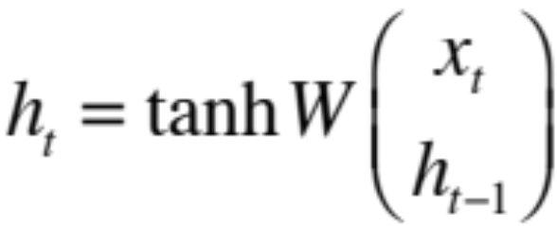
The Vanilla RNN Cell
x_{t}
h_{t-1}
W
h_{t}

Slide 63
The Vanilla RNN Forward
C₁
C₂
C₃
y₁
y₂
y₃
x₁ h₀
x₂ h₁
h₁
x₃ h₂
h₂
h₃

Slide 64
The Vanilla RNN Forward
C₁
C₂
C₃
y₁
y₂
y₃
x₁ h₀
x₂ h₁
h₁
x₃ h₂
h₂
h₃
indicates shared weights

Slide 65
The Vanilla RNN Backward
C₁
C₂
C₃
y₁
y₂
y₃
x₁ h₀
x₂ h₁
h₁
x₃ h₂
h₂
h₃

Slide 66
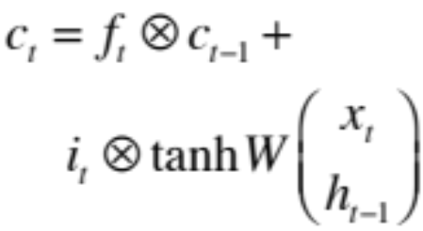
The Popular LSTM Cell
x_{t} h_{t-1}
x_{t} h_{t-1}
W_{i}
W_{o}
Input Gate
i_{t}
Output Gate
o_{t}
Similarly for i_{t}, o_{t}
x_{t}
h_{t-1}
W
Cell
c_{t-1}
h_{t}
f_{t}
Forget Gate
W_{f}
x_{t} h_{t-1}
* Dashed line indicates time-lag

Slide 67
LSTM – Forward/Backward
Go To: Illustrated LSTM Forward and Backward Pass

Slide 68
Class Exercise
Consider the problem of translation of English to French
E.g. What is your name Comment tu t'appelle
Is the below architecture suitable for this problem?
F₁
F₂
F₃
E₁
E₂
E₃
Adapted from http://www.cs.toronto.edu/~rgrosse/csc321/lec10.pdf

Slide 69
Class Exercise
Consider the problem of translation of English to French
E.g. What is your name Comment tu t'appelle
Is the below architecture suitable for this problem?
No, sentences might be of different length and words might not align. Need to see entire sentence before translating
F₁
F₂
F₃
E₁
E₂
E₃
Adapted from http://www.cs.toronto.edu/~rgrosse/csc321/lec10.pdf

Slide 70
Class Exercise
Consider the problem of translation of English to French
E.g. What is your name Comment tu t'appelle
Sentences might be of different length and words might not align. Need to see entire sentence before translating
Input-Output nature depends on the structure of the problem at hand
F₁
F₂
F₃
F₄
E₁
E₂
E₃
Seq2Seq Learning with Neural Networks, Sutskever et al., 2014

Slide 71
Multi-layer RNNs
We can of course design RNNs with multiple hidden layers
y₁
y₂
y₃
y₄
y₅
y₆
x₁
x₂
x₃
x₄
x₅
x₆
Think exotic: Skip connections across layers, across time, …

Slide 72
Bi-directional RNNs
RNNs can process the input sequence in forward and in the reverse direction
y₁
y₂
y₃
y₄
y₅
y₆
x₁
x₂
x₃
x₄
x₅
x₆
Popular in speech recognition

Slide 73
Recap
RNNs allow for processing of variable length inputs and outputs by maintaining state information across time steps
Various Input-Output scenarios are possible
(Single/Multiple)
RNNs can be stacked, or bi-directional
Vanilla RNNs are improved upon by LSTMs which address the vanishing gradient problem through the CEC
Exploding gradients are handled by gradient clipping

Slide 74
The Popular LSTM Cell
x_{t} h_{t-1}
x_{t} h_{t-1}
W_{i}
W_{o}
Input Gate
i_{t}
Output Gate
o_{t}
Similarly for i_{t}, o_{t}
x_{t}
h_{t-1}
W
Cell
c_{t-1}
h_{t}
f_{t}
Forget Gate
W_{f}
x_{t} h_{t-1}
* Dashed line indicates time-lag

Slide 75
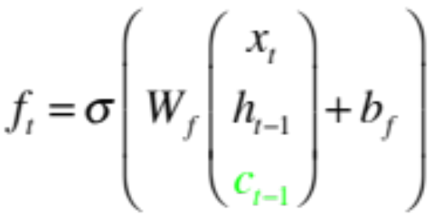
Extension I: Peephole LSTM
x_{t} h_{t-1}
x_{t} h_{t-1}
W_{i}
W_{o}
Input Gate
i_{t}
Output Gate
o_{t}
Similarly for i_{t}, o_{t} (uses c_{t})
x_{t}
h_{t-1}
W
Cell
c_{t-1}
h_{t}
f_{t}
Forget Gate
W_{f}
x_{t} h_{t-1}
* Dashed line indicates time-lag

Slide 76
The Popular LSTM Cell
x_{t} h_{t-1}
x_{t} h_{t-1}
W_{i}
W_{o}
Input Gate
i_{t}
Output Gate
o_{t}
Similarly for i_{t}, o_{t}
x_{t}
h_{t-1}
W
Cell
c_{t-1}
h_{t}
f_{t}
Forget Gate
W_{f}
x_{t} h_{t-1}
* Dashed line indicates time-lag

Slide 77
Extension I: Peephole LSTM
x_{t} h_{t-1}
x_{t} h_{t-1}
W_{i}
W_{o}
Input Gate
i_{t}
Output Gate
o_{t}
Similarly for i_{t}, o_{t} (uses c_{t})
x_{t}
h_{t-1}
W
Cell
c_{t-1}
h_{t}
f_{t}
Forget Gate
W_{f}
x_{t} h_{t-1}
* Dashed line indicates time-lag

Slide 78
Peephole LSTM
Gates can only see the output from the previous time step, which is close to 0 if the output gate is closed. However, these gates control the CEC cell.
Helped the LSTM learn better timing for the problems tested – Spike timing and Counting spike time delays
Recurrent nets that time and count, Gers et al., 2000

Slide 79

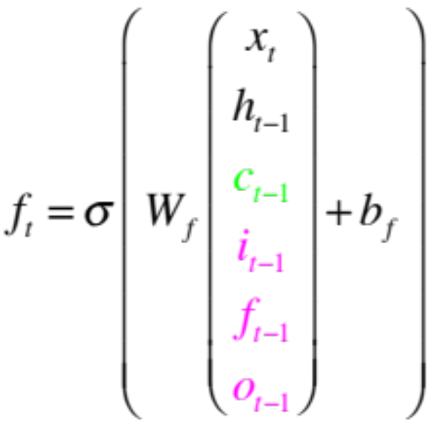
Other minor variants
Coupled Input and Forget Gate
Full Gate Recurrence

Slide 80
LSTM: A Search Space Odyssey
Tested the following variants, using Peephole LSTM as standard:
  No Input Gate (NIG)
  No Forget Gate (NFG)
  No Output Gate (NOG)
  No Input Activation Function (NIAF)
  No Output Activation Function (NOAF)
  No Peepholes (NP)
  Coupled Input and Forget Gate (CIFG)
  Full Gate Recurrence (FGR)
On the tasks of:
  Timit Speech Recognition: Audio frame to 1 of 61 phonemes
  IAM Online Handwriting Recognition: Sketch to characters
  JSB Chorales: Next-step music frame prediction
LSTM: A Search Space Odyssey, Greff et al., 2015

Slide 81
LSTM: A Search Space Odyssey
The standard LSTM performed reasonably well on multiple datasets and none of the modifications significantly improved the performance
Coupling gates and removing peephole connections simplified the LSTM without hurting performance much
The forget gate and output activation are crucial
Found interaction between learning rate and network size to be minimal – indicates calibration can be done using a small network first
LSTM: A Search Space Odyssey, Greff et al., 2015
Notes:
what tasks

Slide 82
Gated Recurrent Unit (GRU)
A very simplified version of the LSTM
  Merges forget and input gate into a single ‘update’ gate
  Merges cell and hidden state
Has fewer parameters than an LSTM and has been shown to outperform LSTM on some tasks
Learning Phrase Representations using RNN Encoder-Decoder for
Statistical Machine Translation, Cho et al., 2014

Slide 83
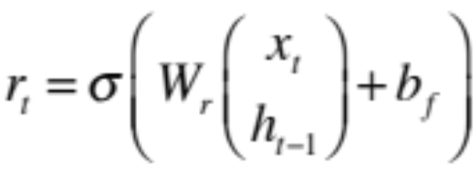
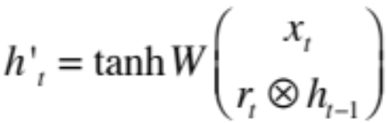


GRU
x_{t} h_{t-1}
W_{z}
Update Gate
z_{t}
x_{t}
W
h’_{t}
h_{t}
h_{t-1}
r_{t}
Reset Gate
W_{f}
x_{t} h_{t-1}

Slide 84
GRU
r_{t}
Reset Gate
W_{f}
x_{t} h_{t-1}

Slide 85
GRU
x_{t}
W
h’_{t}
h_{t-1}
r_{t}
Reset Gate
W_{f}
x_{t} h_{t-1}

Slide 86
GRU
x_{t} h_{t-1}
W_{z}
Update Gate
z_{t}
x_{t}
W
h’_{t}
h_{t-1}
r_{t}
Reset Gate
W_{f}
x_{t} h_{t-1}

Slide 87
GRU
x_{t} h_{t-1}
W_{z}
Update Gate
z_{t}
x_{t}
W
h’_{t}
h_{t}
h_{t-1}
r_{t}
Reset Gate
W_{f}
x_{t} h_{t-1}

Slide 88
An Empirical Exploration of Recurrent Network Architectures
Given the rather ad-hoc design of the LSTM, the authors try to determine if the architecture of the LSTM is optimal
They use an evolutionary search for better architectures
An Empirical Exploration of Recurrent Network Architectures, Jozefowicz et al., 2015

Slide 89
Evolutionary Architecture Search
A list of top-100 architectures so far is maintained, initialized with the LSTM and the GRU
The GRU is considered as the baseline to beat
New architectures are proposed, and retained based on performance ratio with GRU
All architectures are evaluated on 3 problems
  Arithmetic: Compute digits of sum or difference of two numbers provided as inputs. Inputs have distractors to increase difficulty
  3e36d9-h1h39f94eeh43keg3c = 3369 – 13994433 = -13991064
  XML Modeling: Predict next character in valid XML modeling
  Penn Tree-Bank Language Modeling: Predict distributions over words
An Empirical Exploration of Recurrent Network Architectures, Jozefowicz et al., 2015

Slide 90
Evolutionary Architecture Search
At each step
  Select 1 architecture at random, evaluate on 20 randomly chosen hyperparameter settings.
  Alternatively, propose a new architecture by mutating an existing one. Choose probability p from [0,1] uniformly and apply a transformation to each node with probability p
    If node is a non-linearity, replace with {tanh(x), sigmoid(x), ReLU(x), Linear(0, x), Linear(1, x), Linear(0.9, x), Linear(1.1, x)}
    If node is an elementwise op, replace with {multiplication, addition, subtraction}
    Insert random activation function between node and one of its parents
    Replace node with one of its ancestors (remove node)
    Randomly select a node (node A). Replace the current node with either the sum, product, or difference of a random ancestor of the current node and a random ancestor of A.
  Add architecture to list based on minimum relative accuracy wrt GRU on 3 different tasks
An Empirical Exploration of Recurrent Network Architectures, Jozefowicz et al., 2015

Slide 91
Evolutionary Architecture Search
3 novel architectures are presented in the paper
Very similar to GRU, but slightly outperform it
LSTM initialized with a large positive forget gate bias outperformed both the basic LSTM and the GRU!
An Empirical Exploration of Recurrent Network Architectures, Jozefowicz et al., 2015

Slide 92

LSTM initialized with large positive forget gate bias?
Recall
Gradients will vanish if f is close to 0. Using a large positive bias ensures that f has values close to 1, especially when training begins
Helps learn long-range dependencies
Originally stated in Learning to forget: Continual prediction with LSTM, Gers et al., 2000, but forgotten over time
An Empirical Exploration of Recurrent Network Architectures, Jozefowicz et al., 2015

Slide 93
Summary
LSTMs can be modified with Peephole Connections, Full Gate Recurrence, etc. based on the specific task at hand
Architectures like the GRU have fewer parameters than the LSTM and might perform better
An LSTM with large positive forget gate bias works best!

Slide 94
Other Useful Resources / References
http://cs231n.stanford.edu/slides/winter1516_lecture10.pdf
http://www.cs.toronto.edu/~rgrosse/csc321/lec10.pdf
R. Pascanu, T. Mikolov, and Y. Bengio, On the difficulty of training recurrent neural networks, ICML 2013
S. Hochreiter, and J. Schmidhuber, Long short-term memory, Neural computation, 1997 9(8), pp.1735-1780
F.A. Gers, and J. Schmidhuber, Recurrent nets that time and count, IJCNN 2000
K. Greff , R.K. Srivastava, J. Koutník, B.R. Steunebrink, and J. Schmidhuber, LSTM: A search space odyssey, IEEE transactions on neural networks and learning systems, 2016
K. Cho, B. Van Merrienboer, C. Gulcehre, D. Bahdanau, F. Bougares, H. Schwenk, and Y. Bengio, Learning phrase representations using RNN encoder-decoder for statistical machine translation, ACL 2014
R. Jozefowicz, W. Zaremba, and I. Sutskever, An empirical exploration of recurrent network architectures, JMLR 2015

